Slide 1
Two-digit Counter
A project by:
Nourhan Farag Mohamed : 231903707
Malak Mounir Abdellatif : 231903643
Razan Ahmed Fawzy : 221903165
Supervised by:
Dr. Maher Abdel Rasoul
Logic Circuit CCE302
Notes:
When listing all project collaborators, either use commas or bullets

Slide 2
The Idea:
A digital counter circuit is an electronic circuit that counts and records the number of events or pulses. Counters are fundamental components in digital electronics and find applications in various fields, including signal processing, timing, and control systems. They are implemented using flip-flops and combinational logic gates to achieve the counting functionality.
In this circuit we’re using IC 555 and IC 4026 for 7-segment to count from 0 to 99 and then reset.

Slide 3
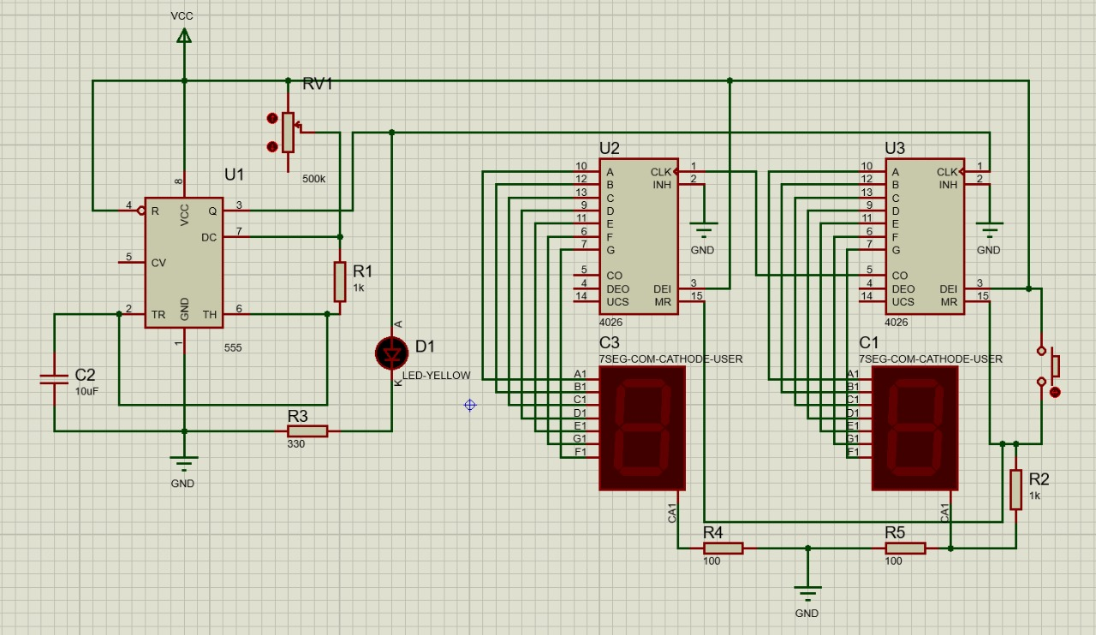
The Schematic

Slide 4
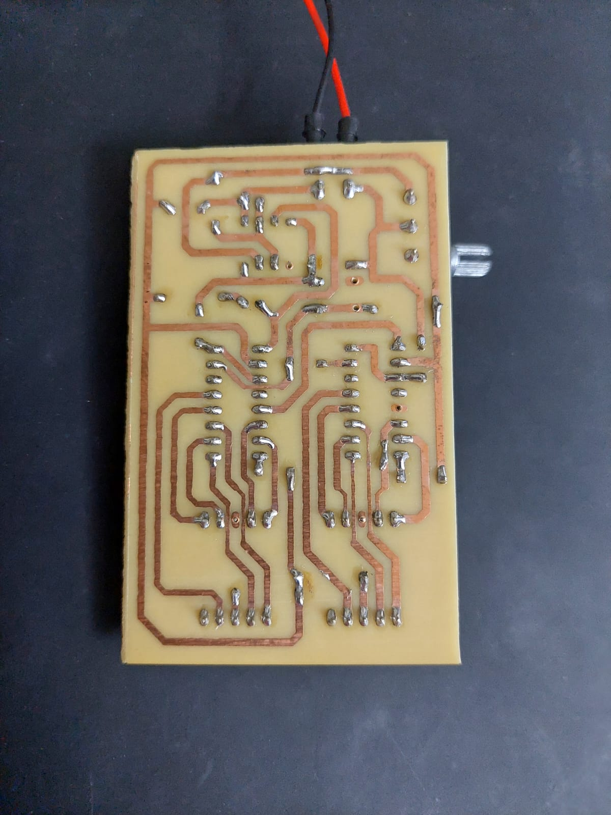
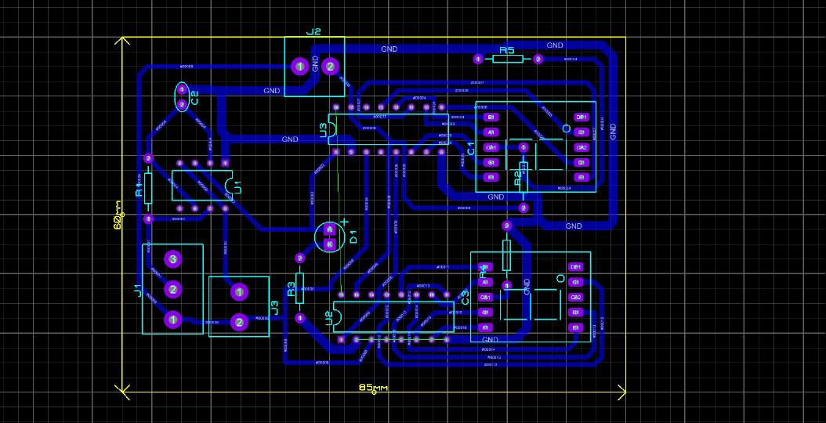
PCB Layout

Slide 5
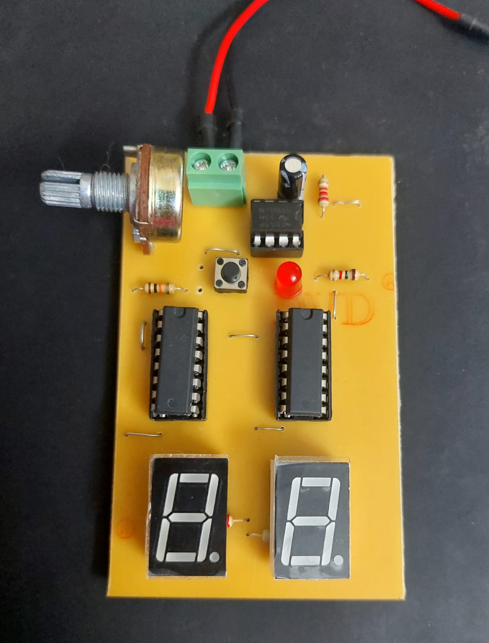
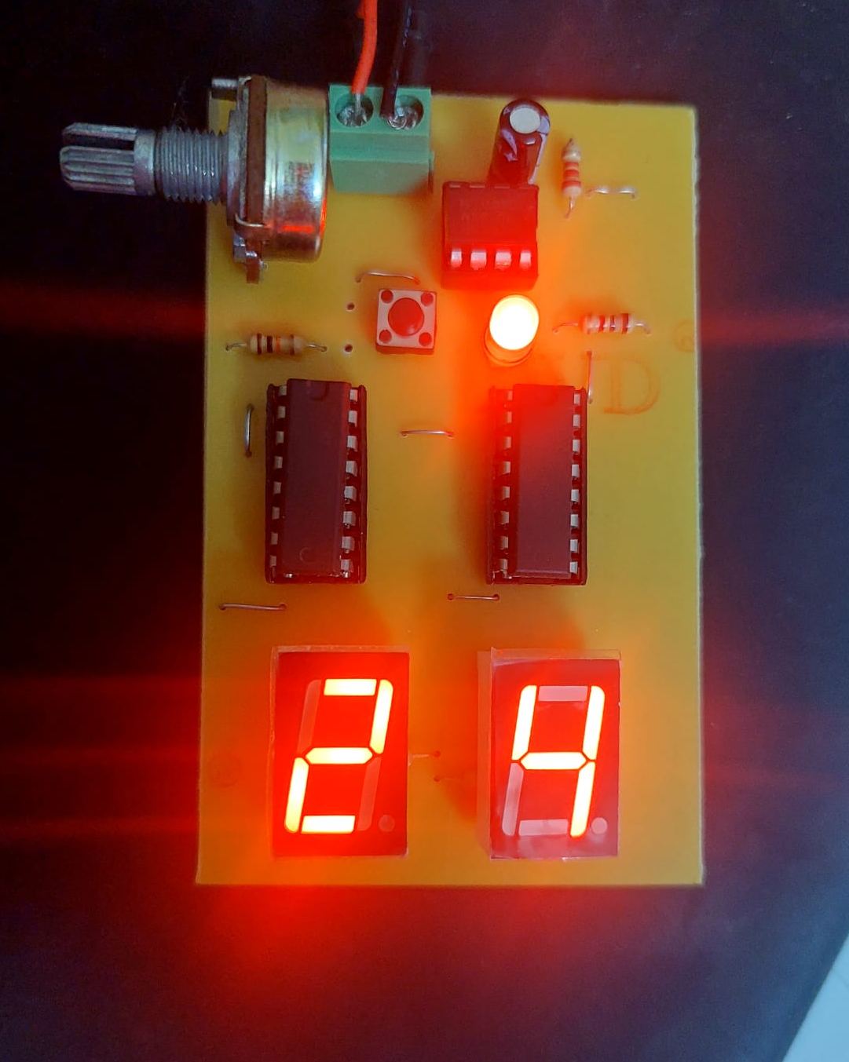
Circuit in Real

